Slide 1


Final Project
Firebase for Homicide and Violent Crime
BDAT 1004
Final Project Presentation
(Group 1)

Slide 2
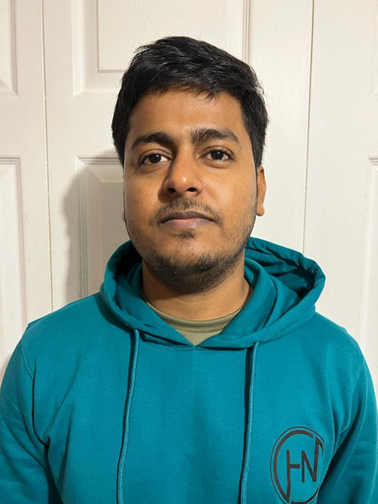

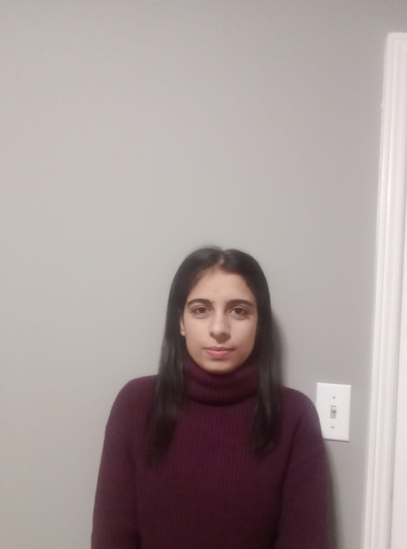
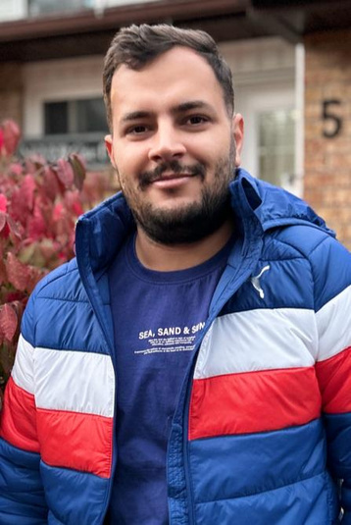
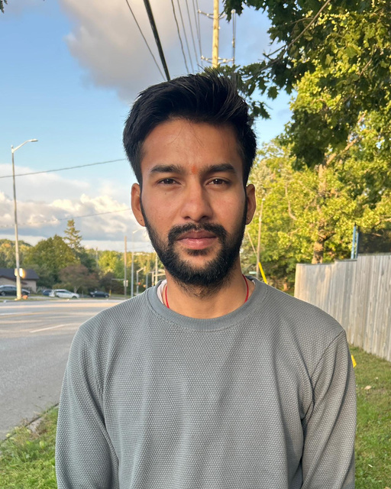
Team Members
JAHIR KHAN
SHUBHANK SHAH
GULJINDER KAUR
NAVJOT SINGH
GAURAV RAUTHAN
DATA ANALYST
BUSINESS ANALYST
DEVELOPER
PROJECT MANAGER
DEVELOPER

Slide 3

Project Summary
We did web scrapping on total 2 datasets: “homicide data” and “violent crime data”.
After performing that, we got to know that USA has highest insights for the same and then we created one we application where we stored our database on “firebase” and our database will run as a “realtime fetching from web scrapping”. Whatever insights we got, we have visualized that in our .ipynb file and on our web application as well.

Slide 4
Project Summary (Continued)
First, when we go to our web application there is one “Login Page” and then after logged in successfully we will be in our application.
Mainly, we have added “Home Page” where all information of our project will fetched and printed as a real time running from firebase database.
Then, we have our “dashboard” where all the insights are visualized properly with different types of plots and graphs.
At the end, we have our “About Us” page where name and picture of our team members are included.

Slide 5


WEB SCRAPPING FOR HOMICIDE DATA

Slide 6
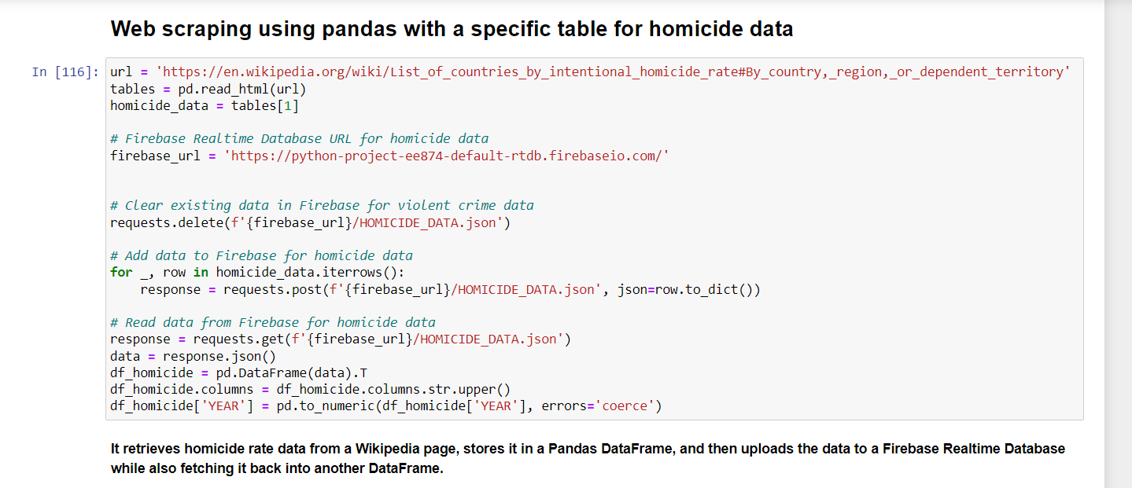



Slide 7
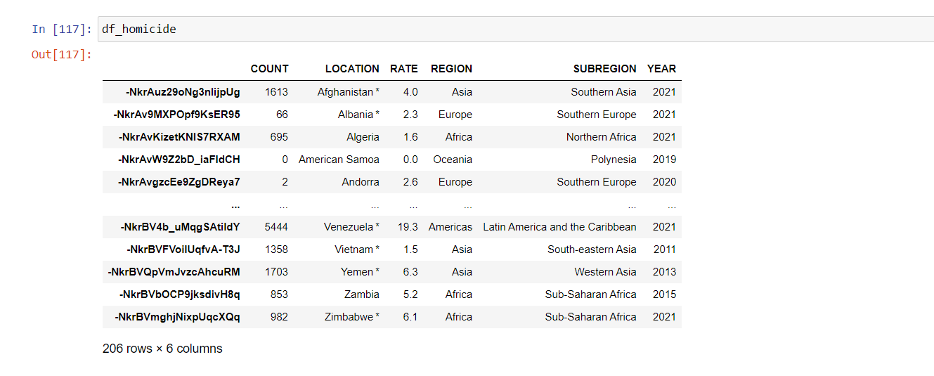

Slide 8
WEB SCRAPPING FOR VIOLENT CRIME DATA

Slide 9
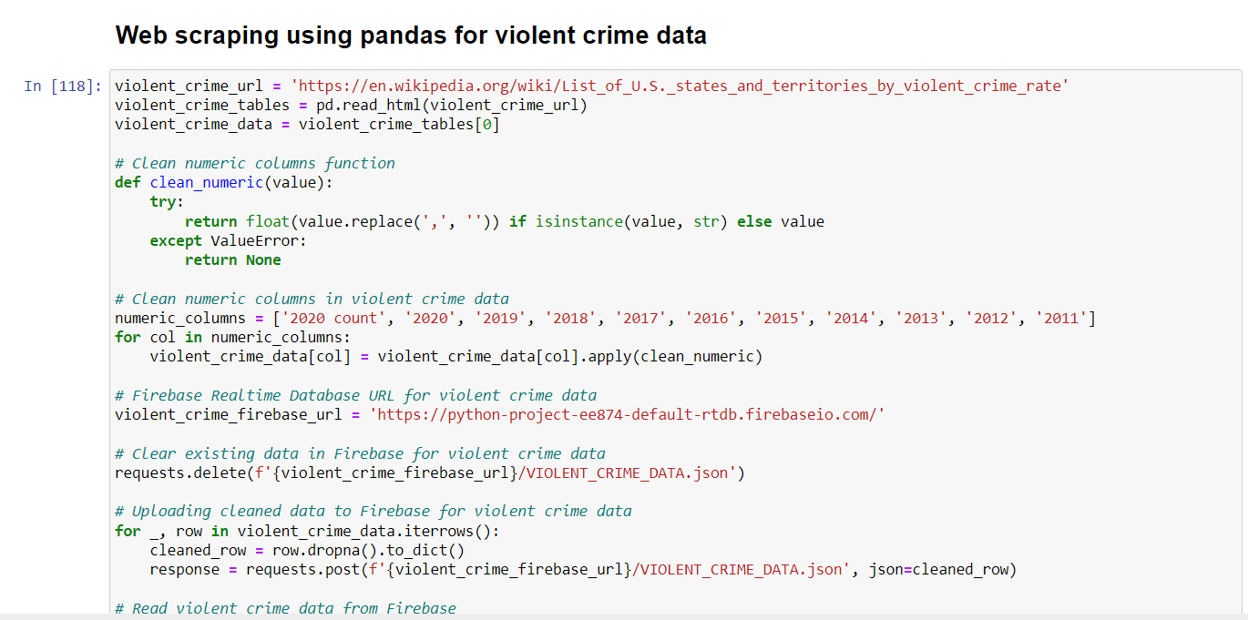

Slide 10
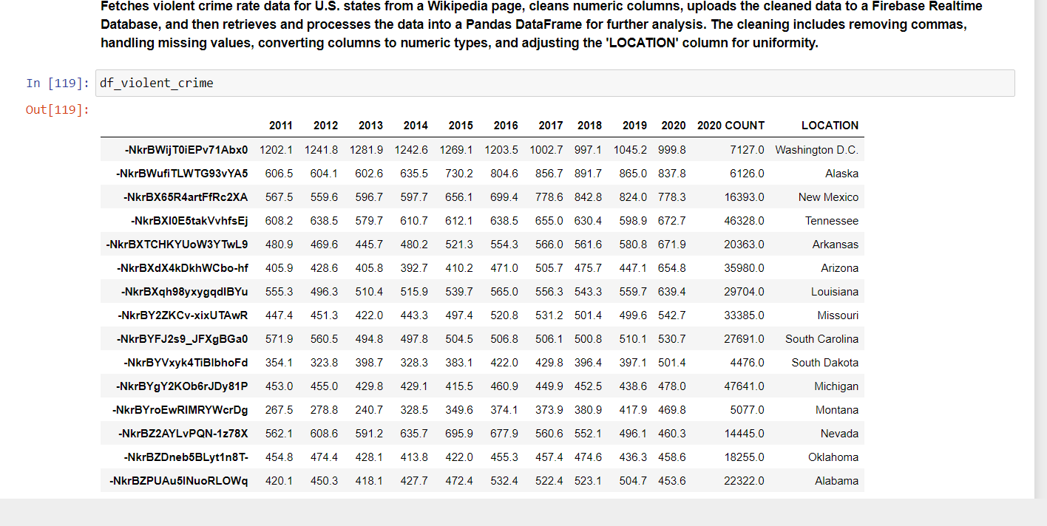

Slide 11
RUN THE APPLICATION (BONUS)

Slide 12
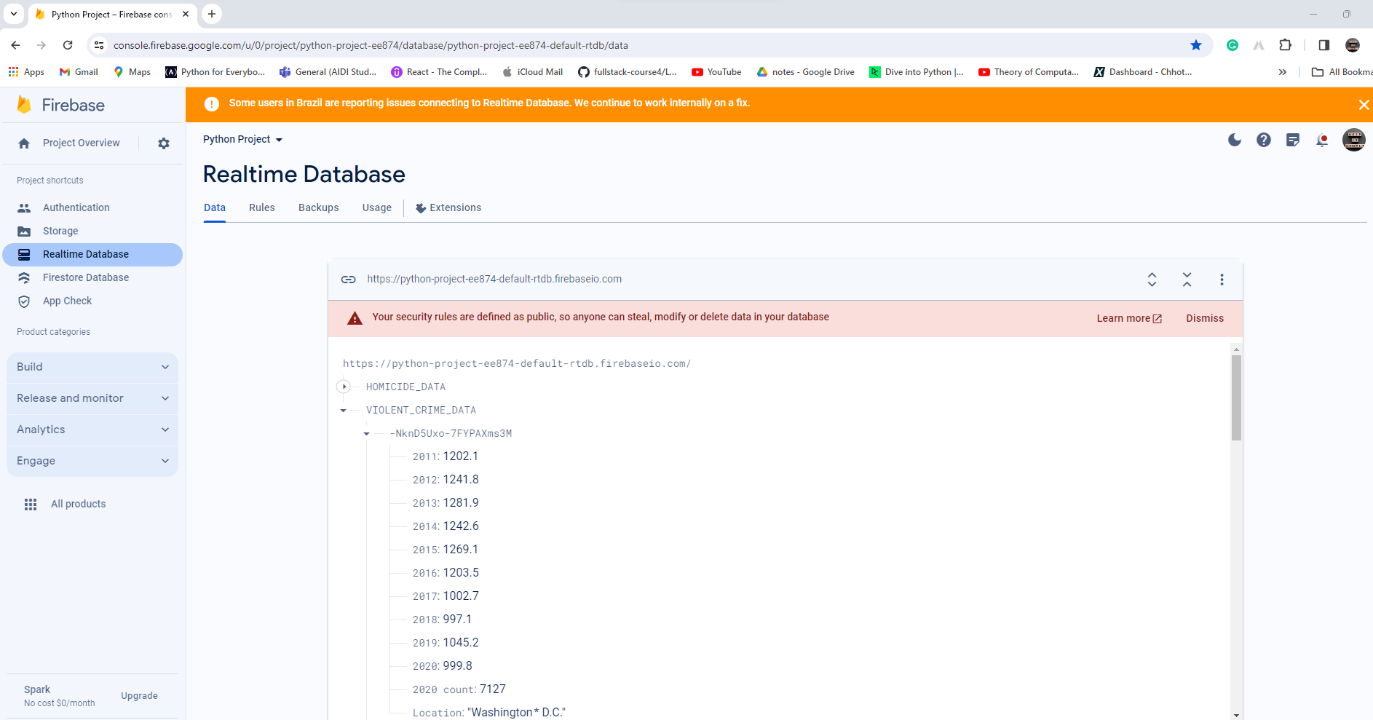

Slide 13
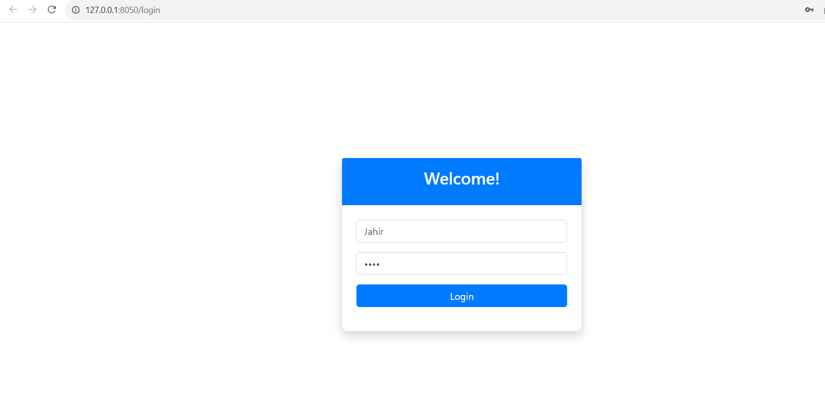

Slide 14
HOME PAGE

Slide 15
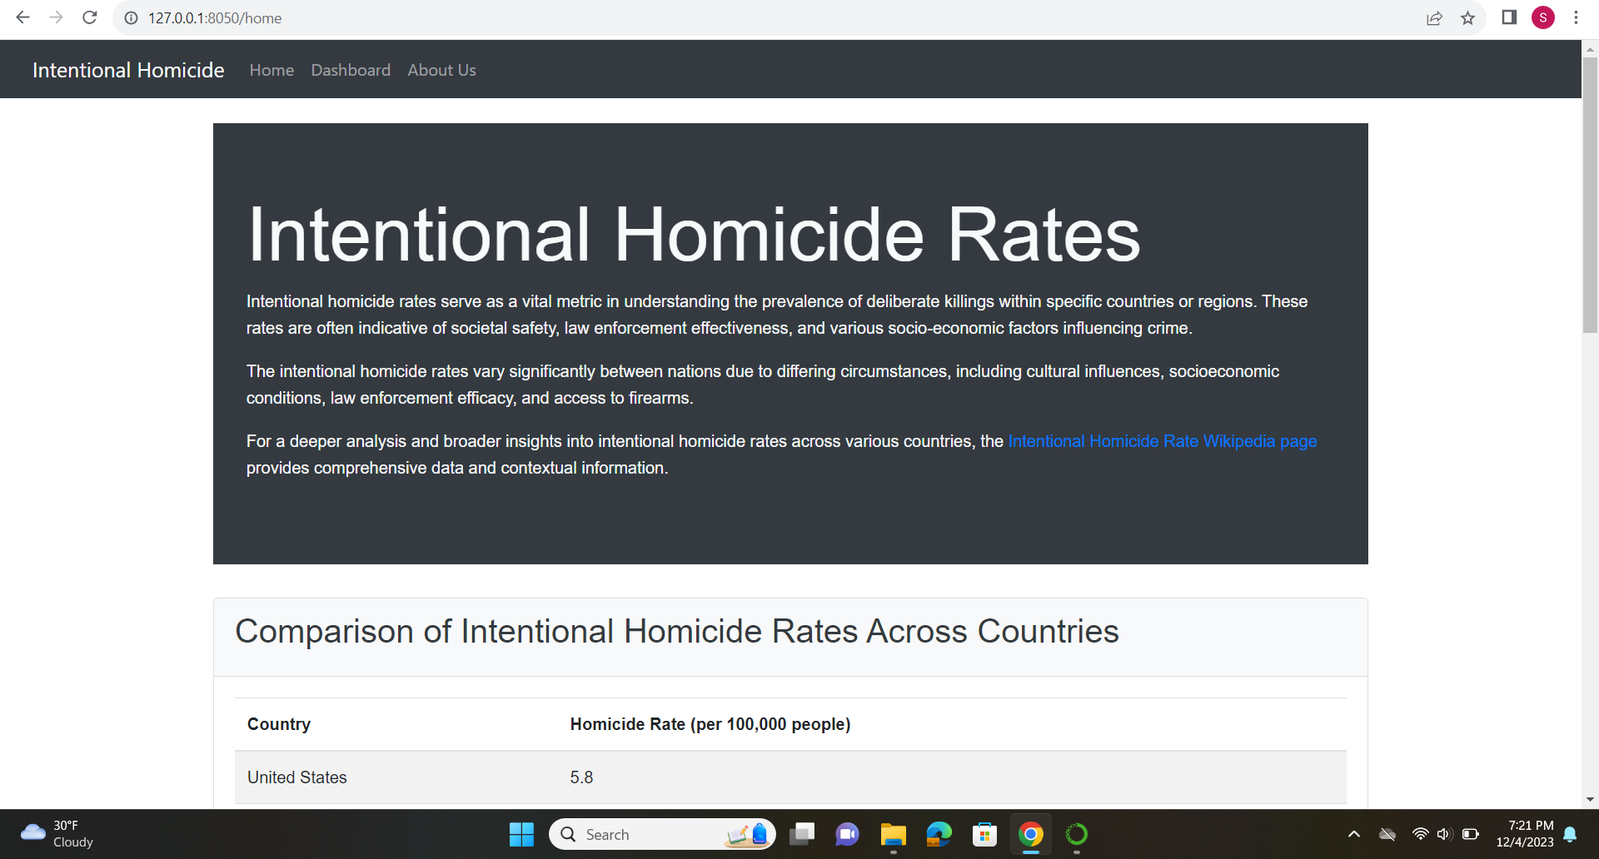

Slide 16
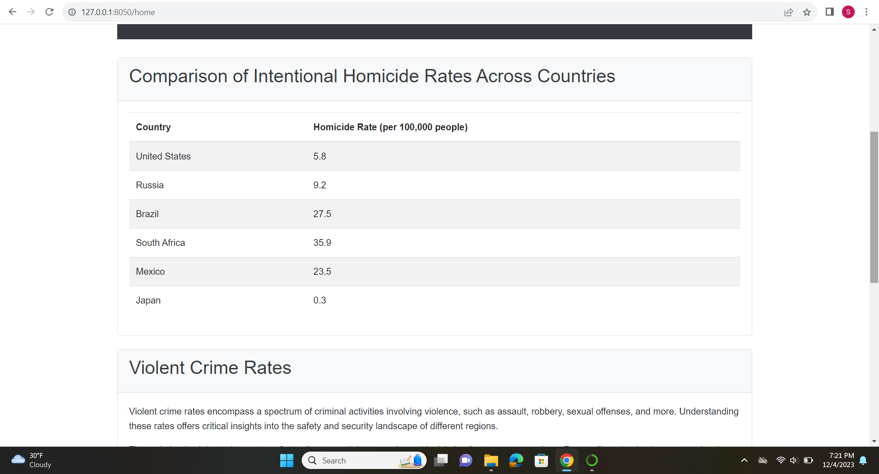

Slide 17
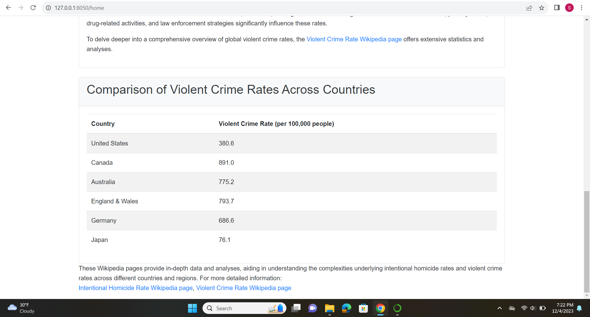

Slide 18
DASHBOARD

Slide 19
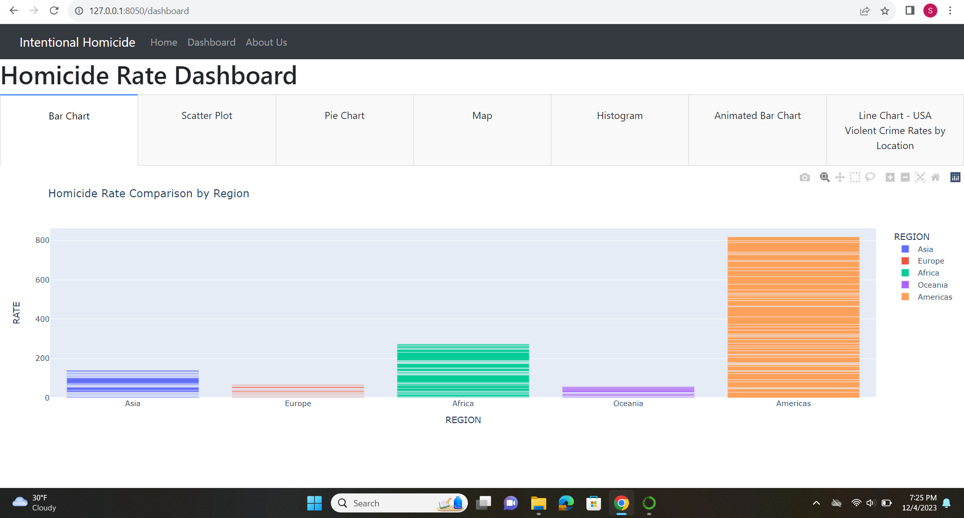

Slide 20
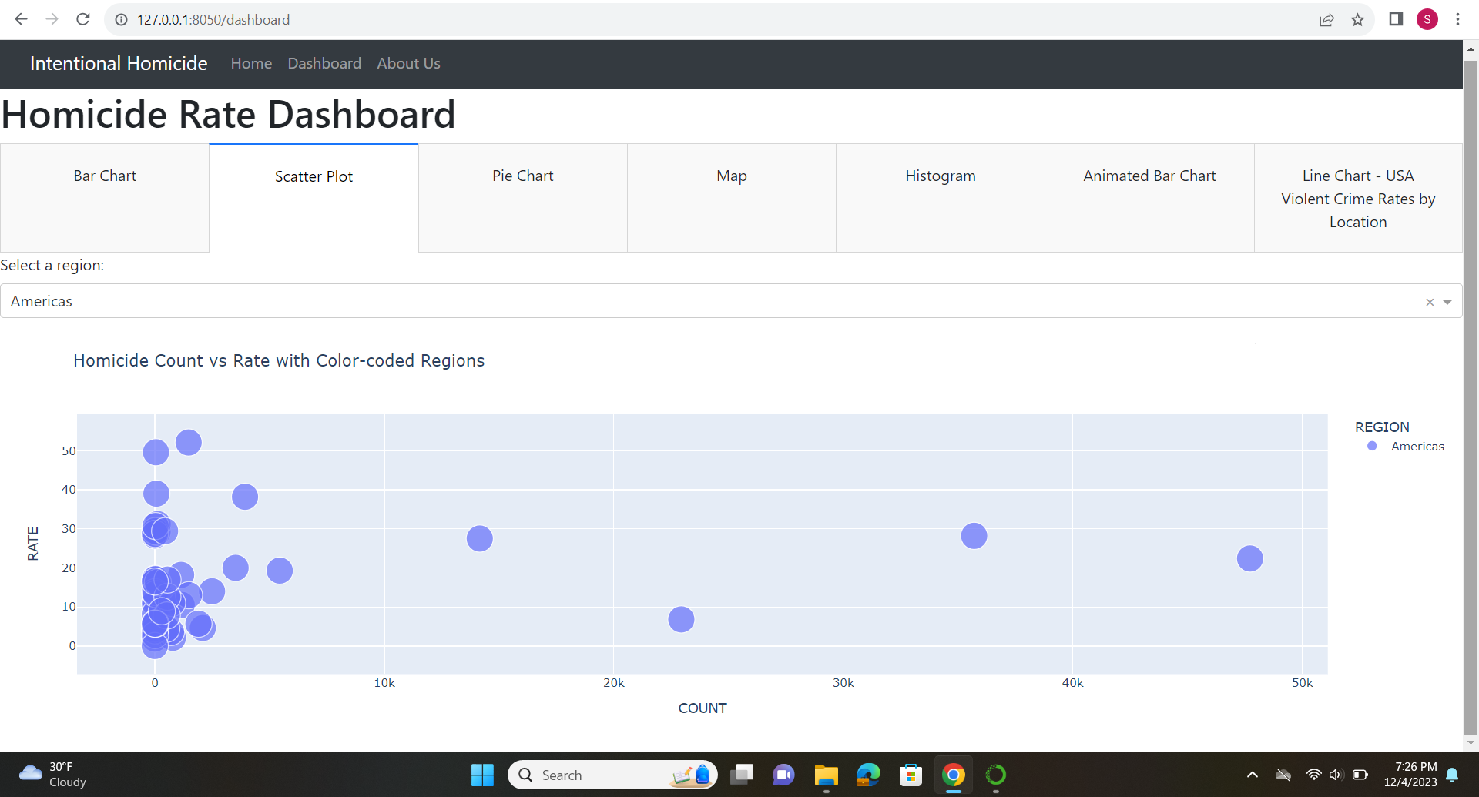

Slide 21
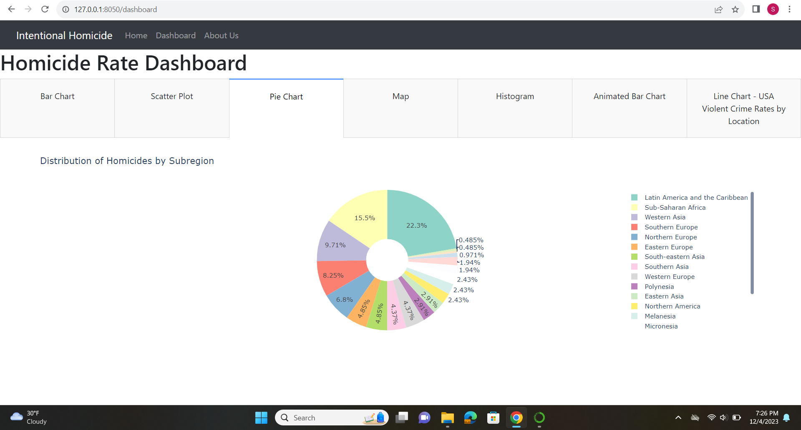

Slide 22
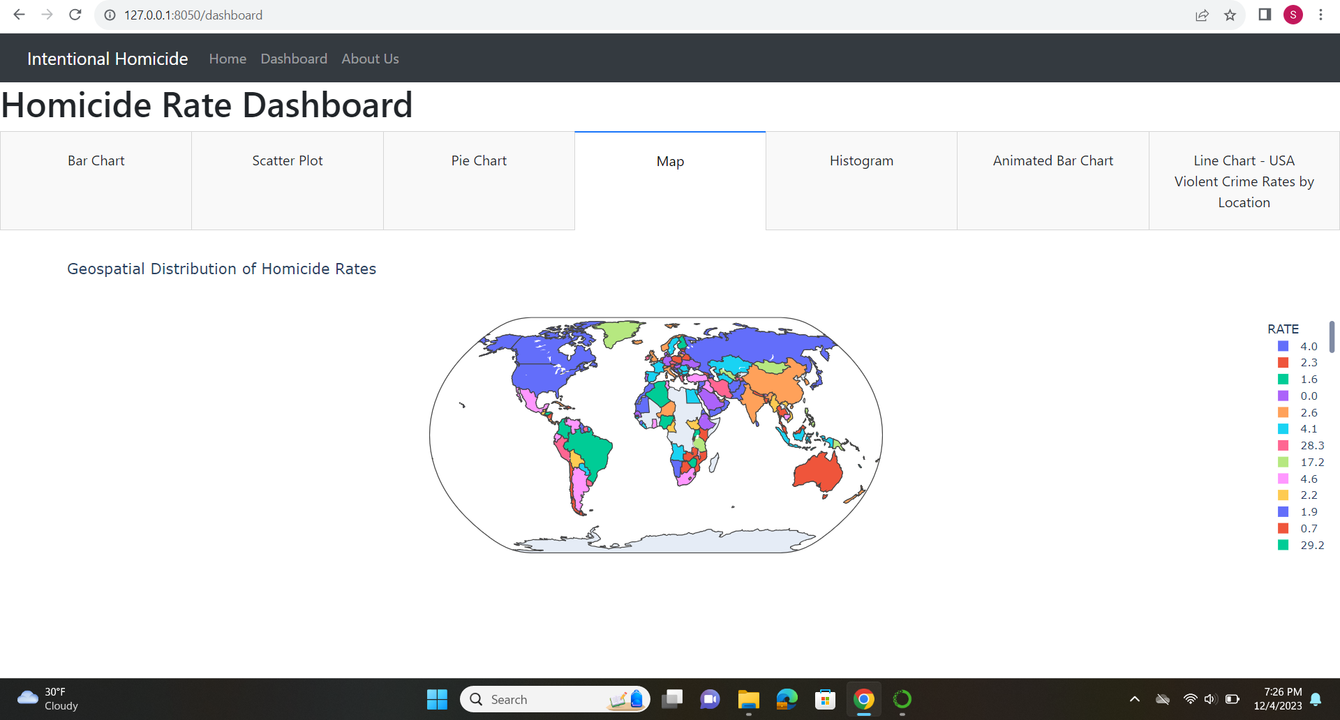

Slide 23
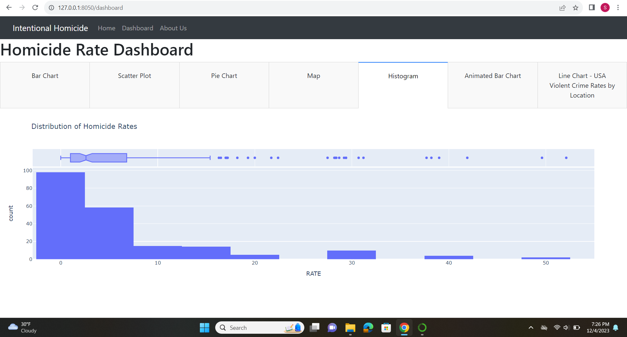

Slide 24
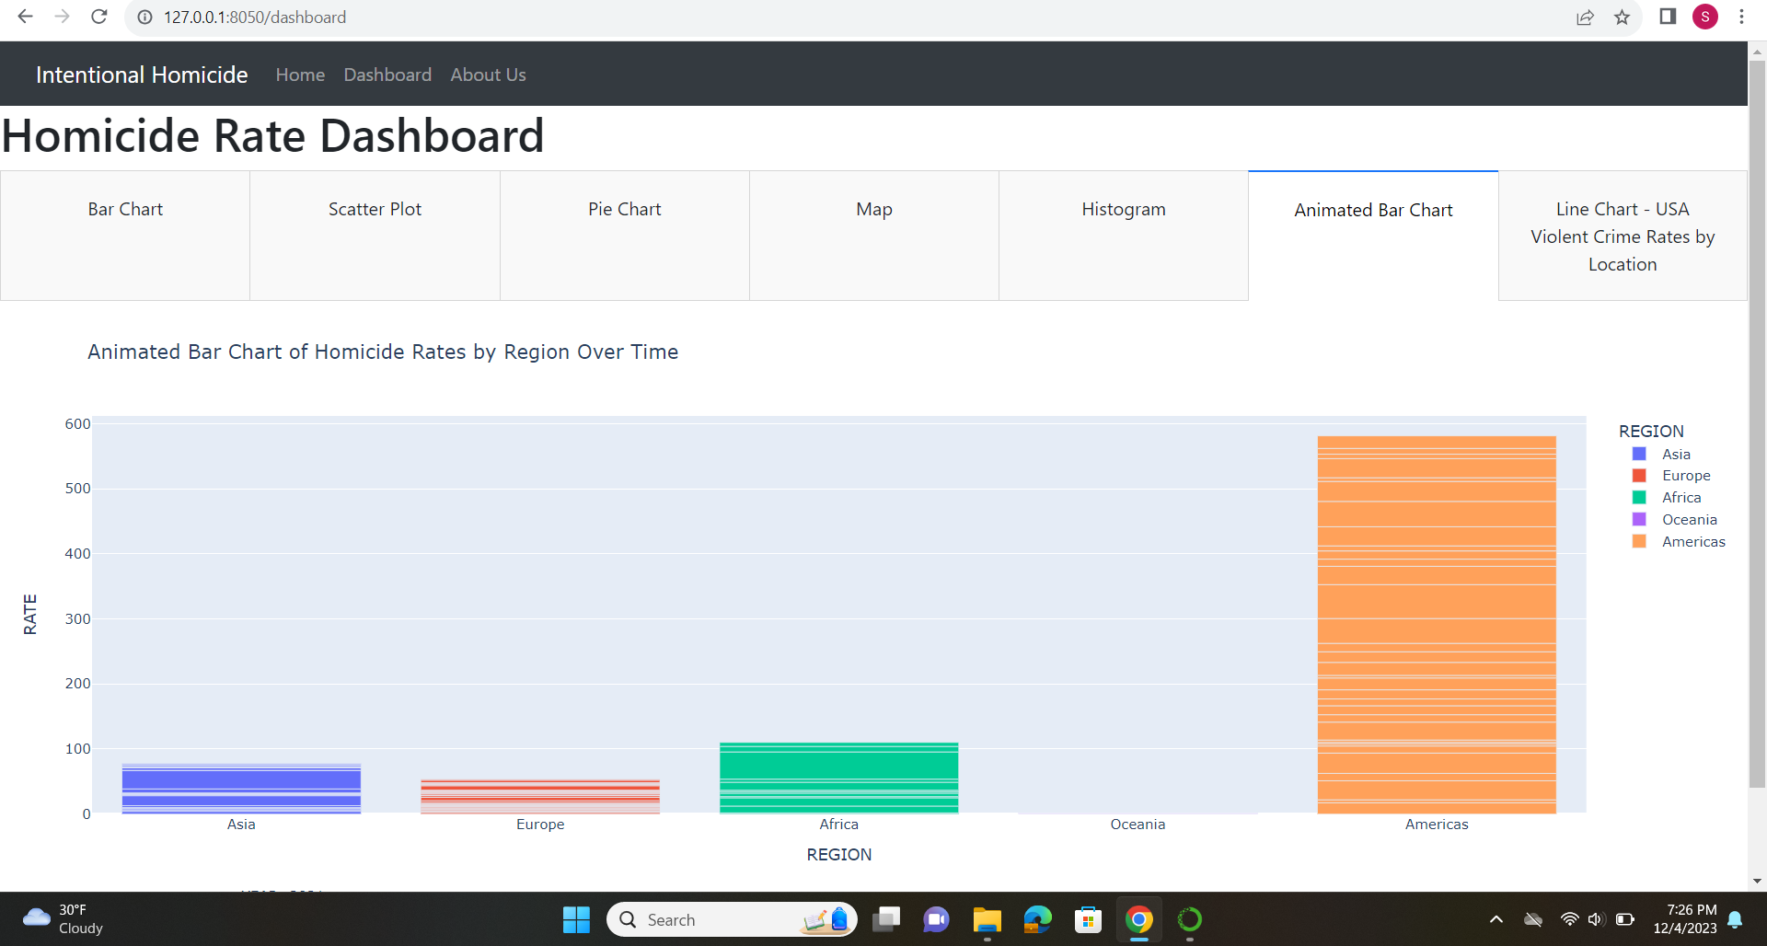

Slide 25
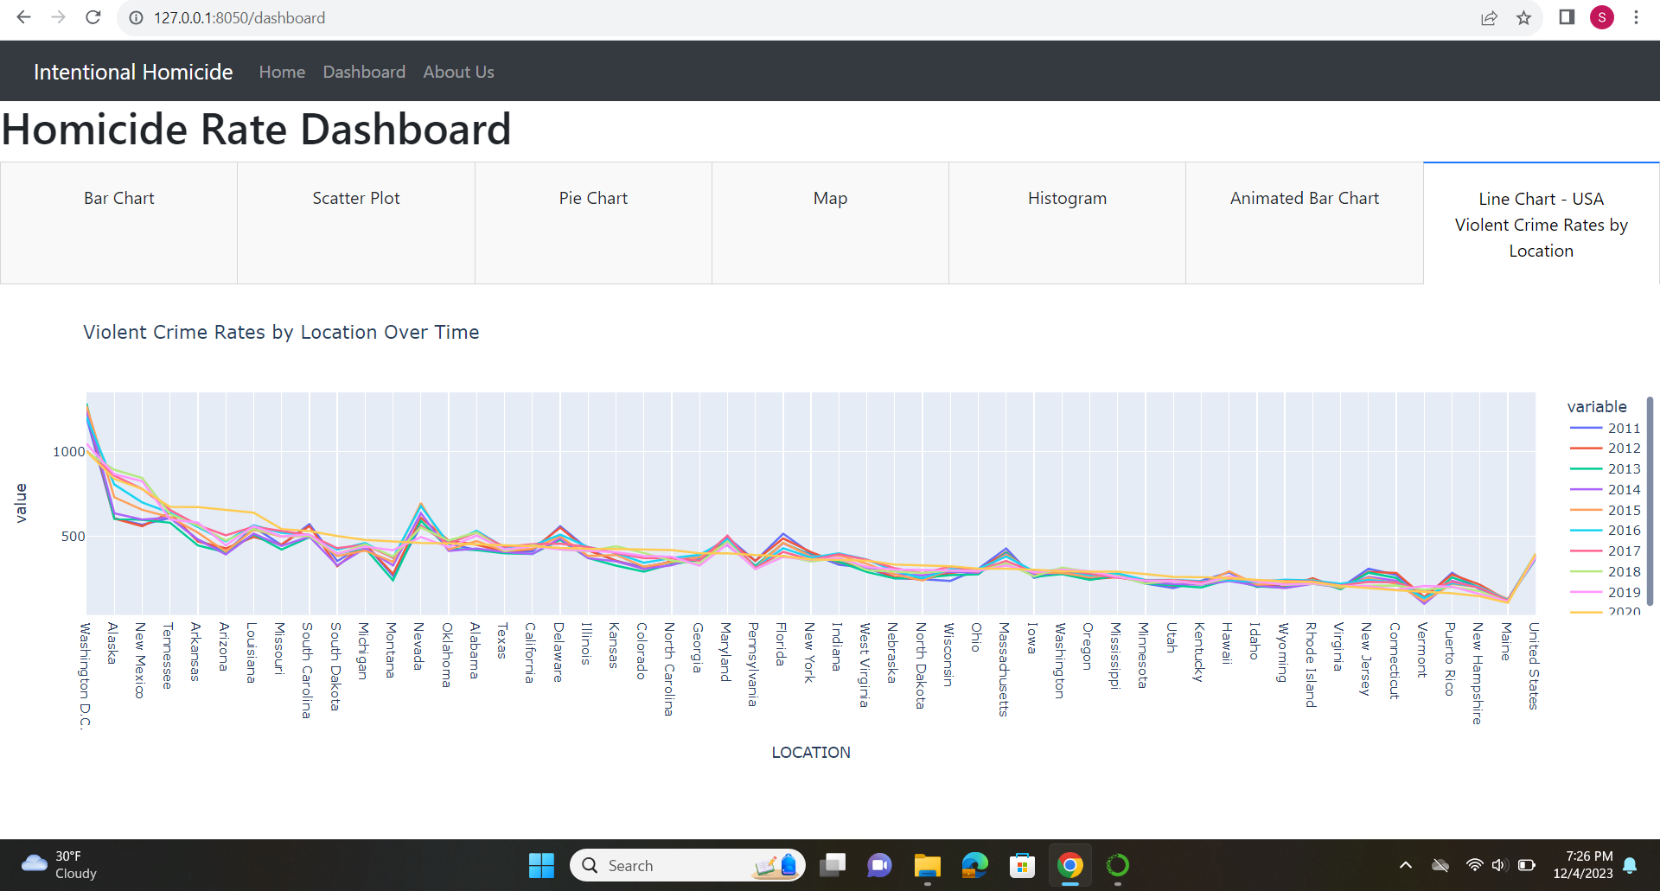

Slide 26
ABOUT US PAGE

Slide 28






THANK
YOU

